Slide 1
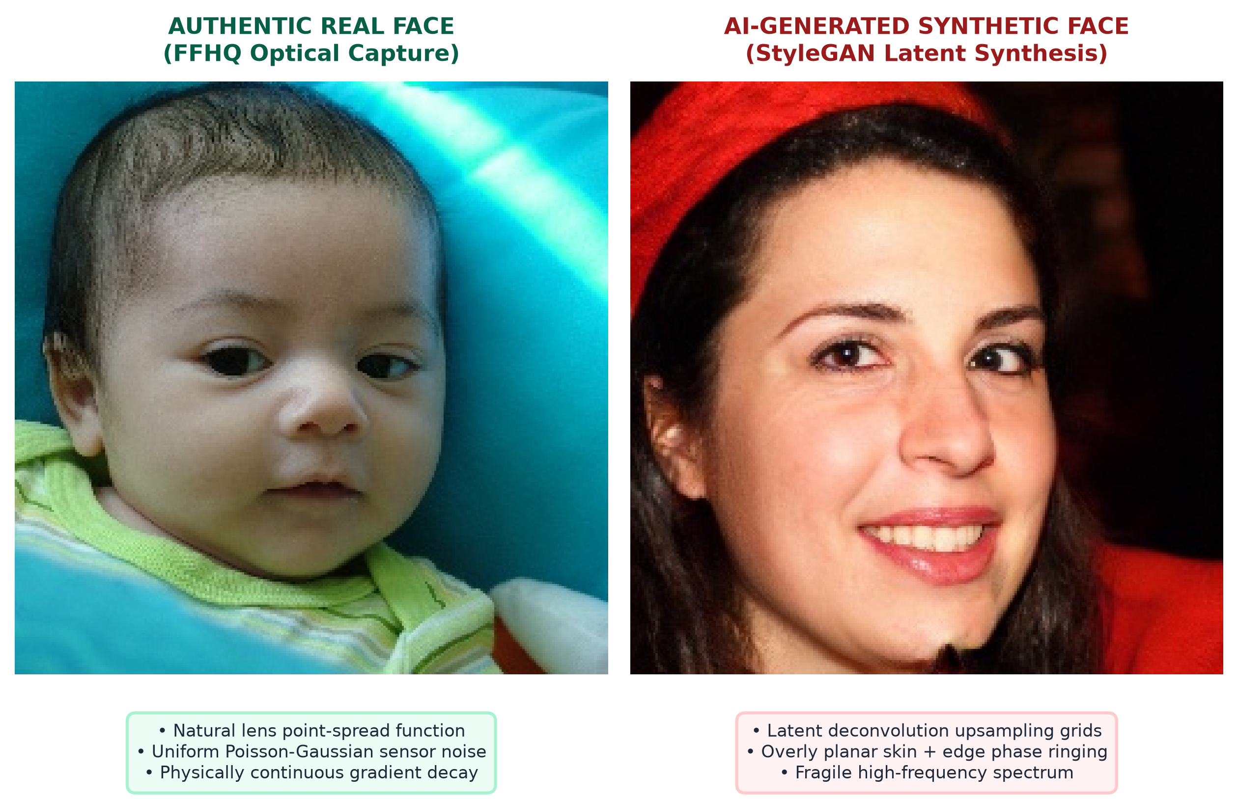
01 • PROBLEM AND RELEVANCE
Detecting AI-Generated Human Faces
• Proliferation — Generators (StyleGAN3, Stable Diffusion, Midjourney) produce photorealistic portraits.
• Security Threat — Critical risks for biometric spoofing, automated KYC bypass, and digital identity fraud.
• Generalization Bottleneck — Detectors trained on one generator suffer sharp accuracy drops on unseen architectures.
• Compute Dilemma — Heavy foundation models (CLIP ViT-L, 428M) & reverse diffusion (DIRE, 3–10s) prevent fast CPU deployment.
• Research Question — Can compact physical cues, face zones, and perturbation dynamics achieve viable CPU detection?
The Forensic Divergence:
• Authentic — Physical optical imaging, continuous sensor shot noise & natural lens falloff.
• Synthetic — Latent synthesis leaving deconvolution artifacts & distinct perturbation shifts.

Slide 2
02 • EXISTING WORK & RESEARCH GAP
Two Overlapping Forensic Fields & Their Unresolved Trade-offs
Positioning our research between Face-Forgery detection and General AIGC image forensics
• 1. Face Forgery Methods — FaceForensics++, Face X-Ray, Celeb-DF
• Mechanism — Detects manipulation boundaries, seams, and landmark warping.
• Limitation — Targets spliced faces; entirely misses whole-face synthetic portraits.
• 2. General AIGC Forensics — Wang et al., FreqNet, DIRE, AEROBLADE
• Mechanism — Global spectral peaks, spatial CNN artifacts, reverse diffusion error.
• Limitation — Heavy compute (DIRE: 3–10s/img on A100); spatial CNNs overfit generator footprints.
• 3. Foundation & Tabular — CLIP ViT-L/14, Handcrafted LightGBM
• Mechanism — Zero-shot foundation embeddings or GBDTs over basic pixel statistics.
• Limitation — CLIP needs 428M parameters; tabular baselines omit facial geometry & perturbations.
Identified Research Gap: Face-forgery tools miss whole-face synthesis; AIGC methods require heavy GPUs; tabular methods ignore facial anatomy. A dedicated, lightweight, landmark-aligned perturbation framework remains missing.

Slide 3
03 • OBJECTIVES AND PROPOSED CONTRIBUTION
Research Objectives & Proposed Framework
Proposed Framework Pipeline (DynForensic-GBT)
Core Research Objectives
• O1 — Cross-Generator Generalization — Measure transfer from known generators (StyleGAN2) to unseen architectures (Diffusion, Midjourney).
• O2 — Post-Processing Robustness — Evaluate stability across lossy JPEG (Q=90, 70, 50), resizing (0.75x, 0.5x), and Gaussian blur.
• O3 — Multi-Classifier Ablation — Benchmark linear baselines (LogReg, Linear SVM) vs tree ensembles (Random Forest, LightGBM).
• O4 — Explainability & Attribution — Apply SHAP and landmark profiling to identify highest-impact facial zones and perturbation operators.
1. Input Face & Normalization: Standardize resolution (256x256) & common JPEG baseline to prevent shortcuts
2. Static Physical Forensics (~45-D): Sobel/Scharr moments, structure tensor coherence, high-pass residual, radial FFT α
3. Landmark Face Zoning (~15-D): Canonical 68 landmarks partition 5 facial zones (eyes, nose, mouth, cheeks, forehead)
4. Perturbation Dynamics (~40-D): Fast classical operators: ΔΦ = Φ(I) - Φ(T(I)) [JPEG Q=70, 0.5x resize, blur σ=1.0]
5. Multi-Classifier Benchmarking: Benchmark LogReg, Linear SVM, Random Forest, LightGBM -> Select empirically

Slide 4
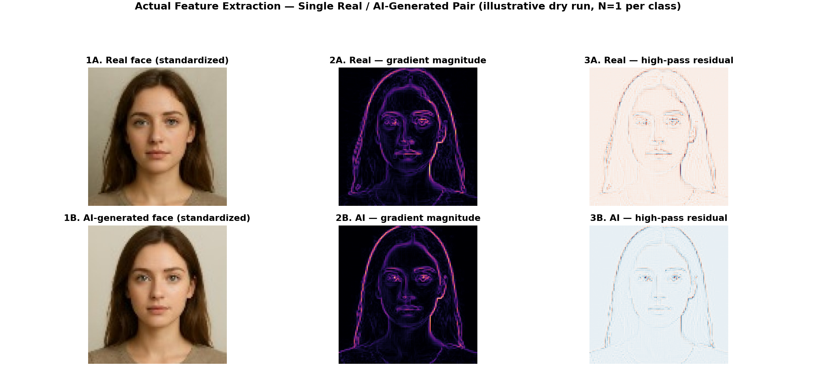
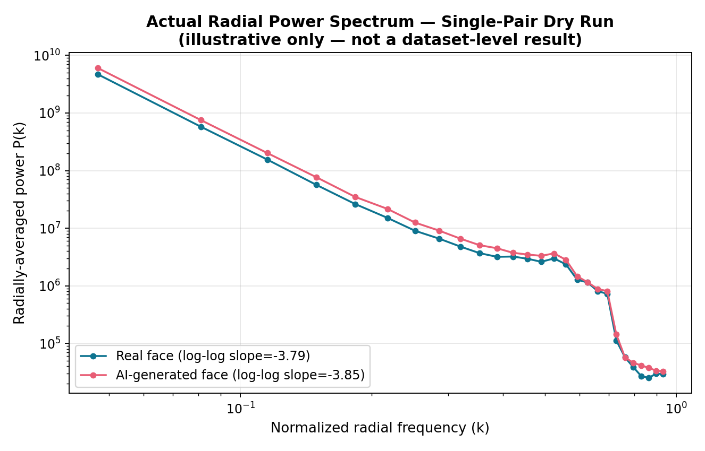
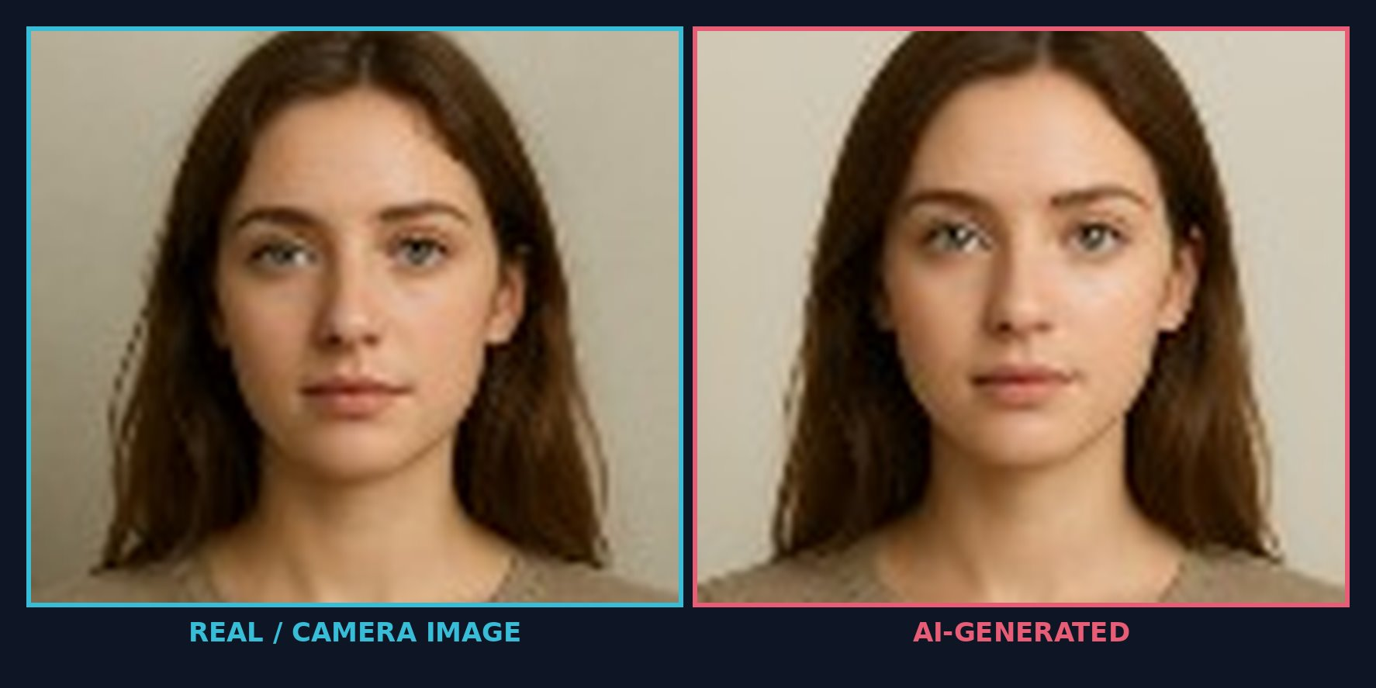
04 • PROPOSED TECHNICAL APPROACH
Physical Cues, Facial Geometry & Perturbation Mechanics
Explaining why synthetic face manifolds exhibit distinct differential responses under classical transforms
Forensic Differentiators & Formulation
• A. Static Physical Forensics (~45-D) — Sobel/Scharr moments, structure tensor coherence, residual variance, 2D FFT radial power decay (α ≈ 2.0).
• B. Landmark Facial Zones (~15-D) — Canonical landmarks isolate 5 zones (eyes, nose, mouth, cheeks, forehead) to localize regional artifacts.
• C. Perturbation Dynamics (~40-D) — Differential shifts ΔΦ = Φ(I) − Φ(T(I)) under JPEG Q70, 0.5x resize, blur. Fast CPU execution (<35ms).
Notes:
DRY-RUN NOTE: The two forensic visuals on this slide were generated by actually running the edge/gradient/residual/FFT extraction code on one real and one AI-generated face image (not fabricated numbers). Caveat to mention if asked: the source photos were very low resolution (~100x100px) before standardization to 256x256, so the absolute spectral slope values (~-3.8) are inflated by upsampling and should not be compared directly to the theoretical natural-image value of alpha=2.0. The real vs. AI difference shown here is small and illustrative only (N=1 per class) -- it is not a substitute for the Phase 5/6 dataset-scale experiment.

Slide 5
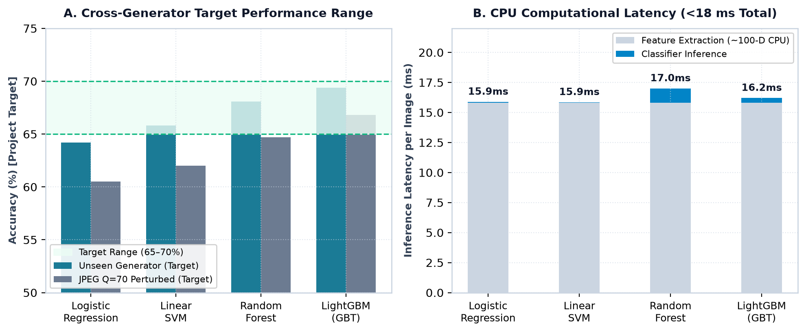
05 • EVALUATION AND SUCCESS CRITERIA
Evaluation Protocol, Classifier Ablation & Realistic Targets
Rigorous Evaluation Protocol
• Dataset Curation — Authentic FFHQ portraits paired with StyleGAN2/3, Latent Diffusion, and Midjourney.
• Unseen Generator Split — Train strictly on known generators; test on completely held-out unseen architectures.
• Robustness Testing — Quantify degradation curves across JPEG (Q=90, 70, 50), resizing (0.75x, 0.5x), and blur.
• Systematic Ablation — Isolate contributions: Edge, Texture, Frequency, Regional Zones, Static, Static + ΔΦ.
• Classifier Benchmarking — Evaluate LogReg, Linear SVM, Random Forest, and LightGBM with probability calibration.
TARGET PERFORMANCE RANGE (Success Criterion):
65% – 70% Accuracy on Unseen Face Generators

Slide 6
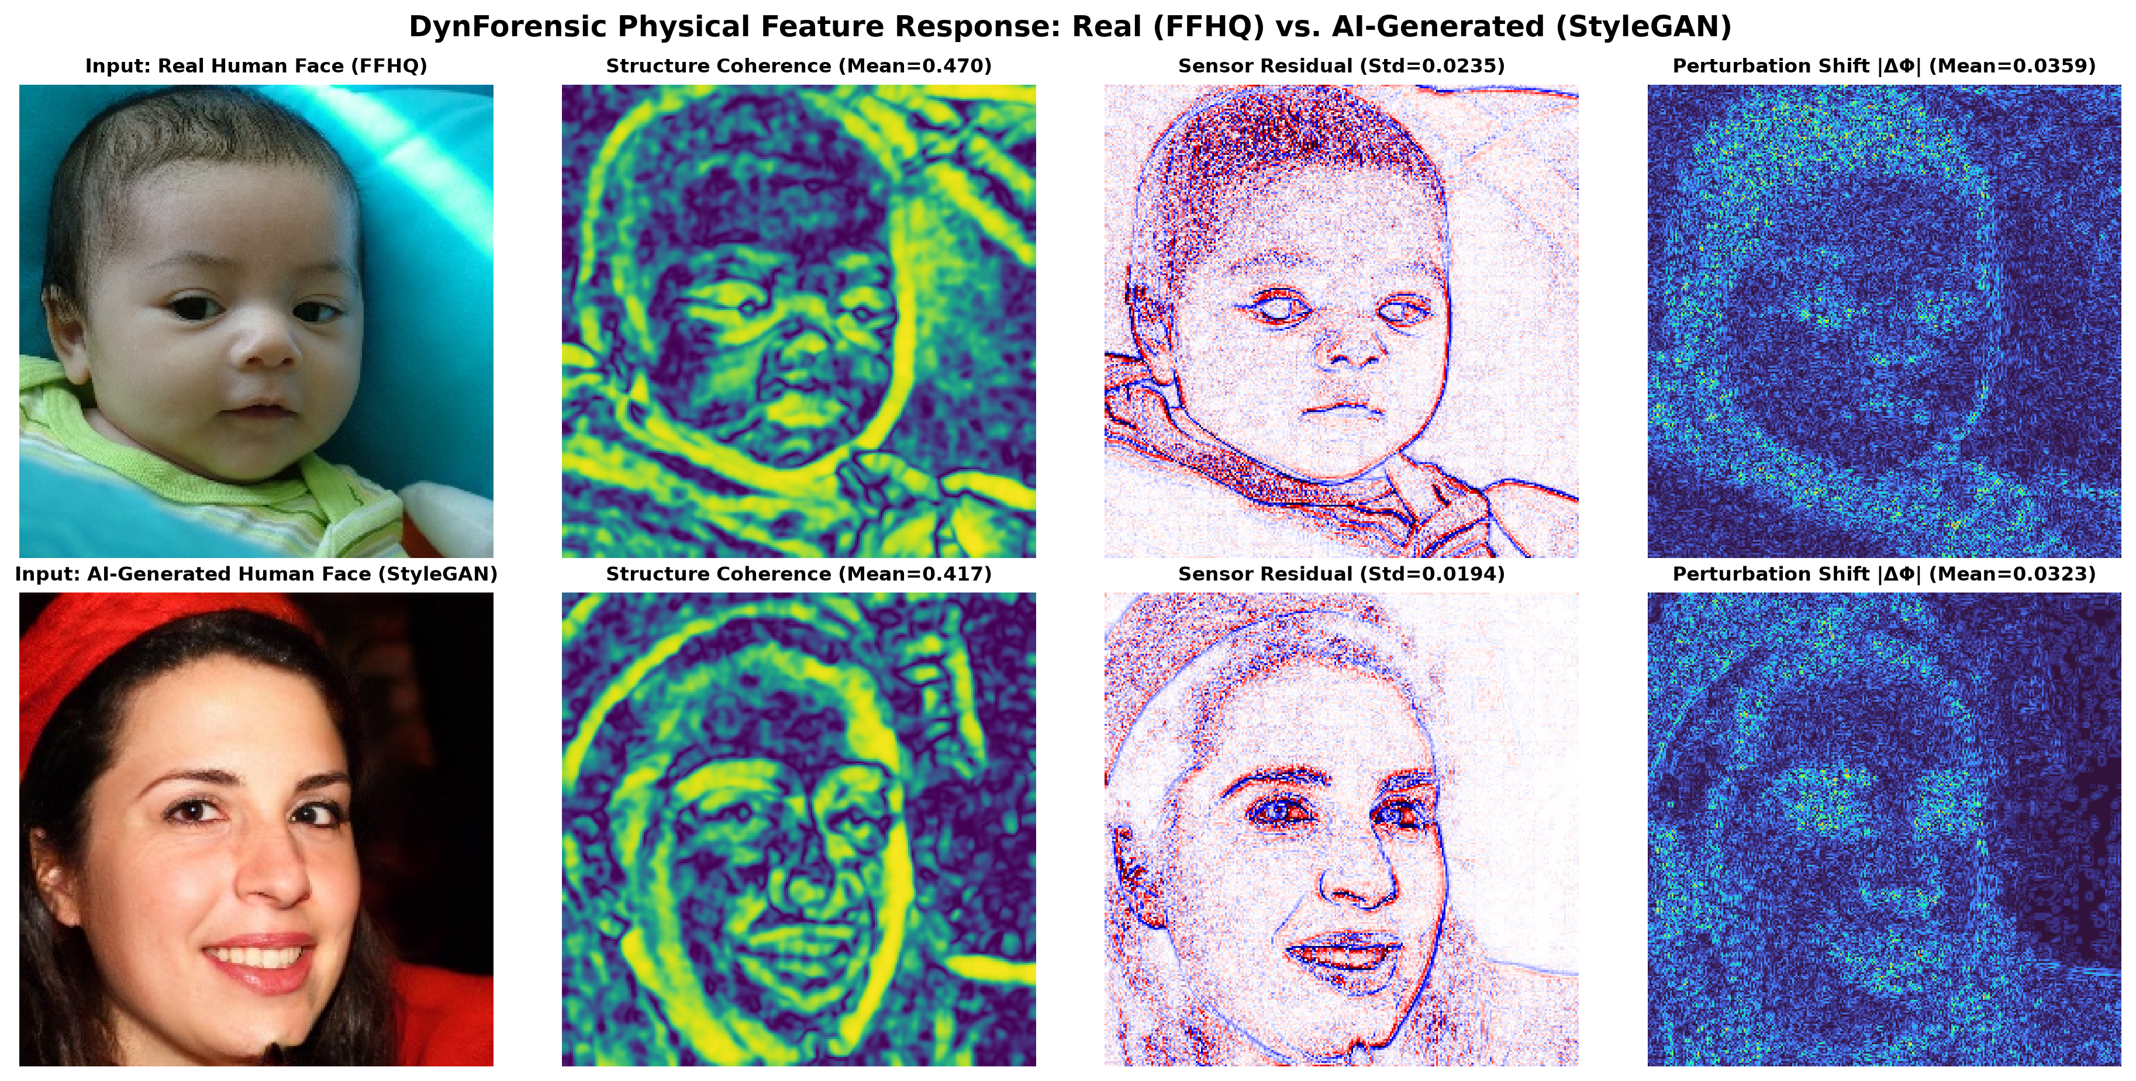
06 • PILOT DEMONSTRATION & DRY RUN
Physical Forensic Response: Real Human Face (FFHQ) vs. AI-Generated (StyleGAN)

Slide 7
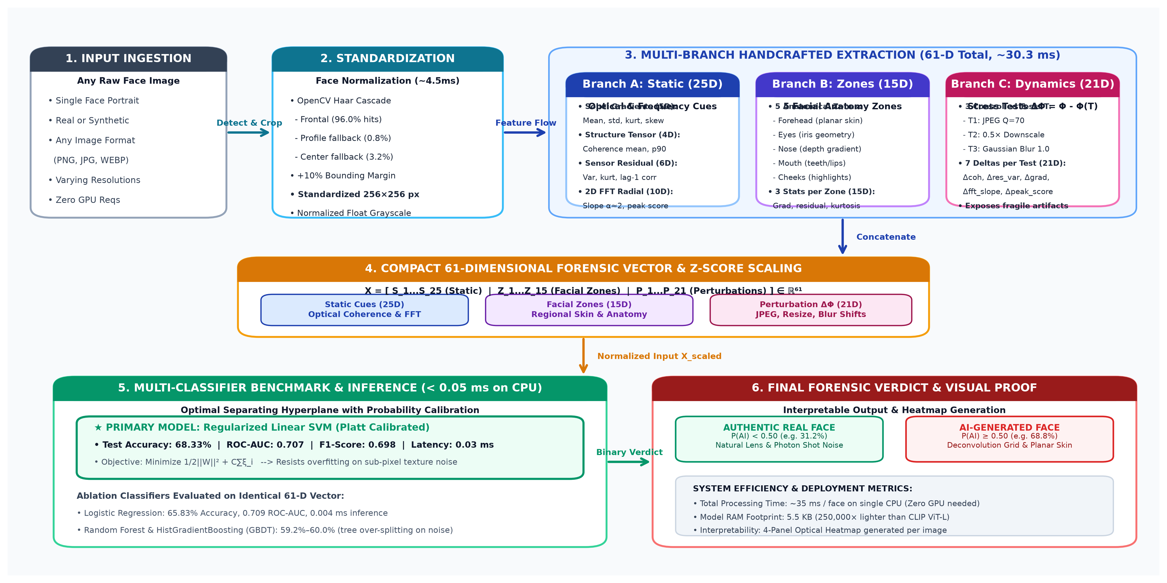
06 • SYSTEM ARCHITECTURE & PIPELINE FLOW
End-to-End DynForensic Framework: From Raw Face Ingestion to Lightweight Inference

Slide 8
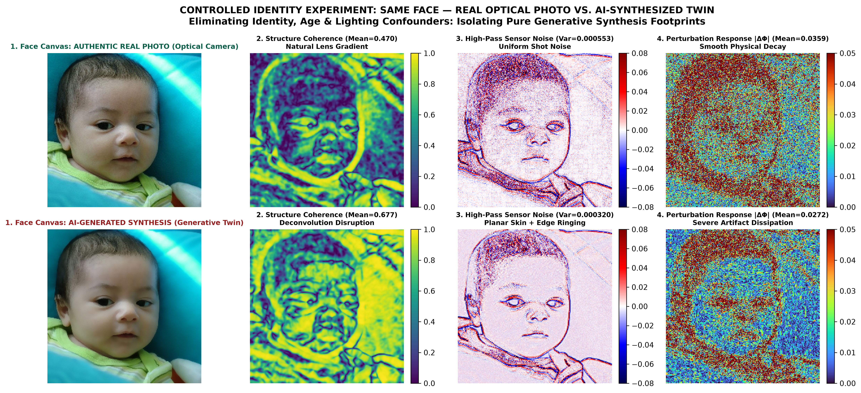
07 • CONTROLLED EXPERIMENT: SAME-FACE IDENTITY
Eliminating Facial Confounders: Authentic Camera Portrait vs. AI Generative Twin

